Slide 1
Hormones
https://biologydictionary.net/endocrine-system/
https://kidshealth.org/en/parents/endocrine.html
https://www.britannica.com/science/human-endocrine-system/Traditional-endocrinology
https://www.innerbody.com/image/endoov.html
IGCSE Biology
Coordination and response

Slide 2
Hormones
https://www.britannica.com/animal/animal/Hormones#ref405262
Definition:
A hormone is a chemical substance, produced by a gland, carried by the blood, which alters the activity of one or more specific target organs and is then destroyed by the liver.
Endocrine glands are also called ductless glands. Endocrine glands are usually heavily vascularized, containing a dense network of blood vessels.
Endocrine glands in animals are the hypothalamus, the pituitary gland, the pineal gland, the thyroid, the parathyroid, the thymus, the pancreas, the adrenal gland and the gonads (9 in total).
Not all cells in the body react to hormones, the cells who react are called target cells.
Notes:
Hormones can be proteins, single polypeptides, amines, or steroids or other lipids. Hormones travel to their place of action via the circulatory system and then match their particular configuration with a specific receptor molecule attached to a cell membraneor, more usually, located within the cell.

Slide 3
Functions of hormones
Functions of hormones in Animals
Ensures proper growth
Responsible to look after the maturing and development in a proper time frame
Makes sure reproduction happens at the right time
For instance, Thyroid secretes two hormones: Thyroxine (T4) and Thyronine (T3) which affects everyday metabolism.

Slide 4
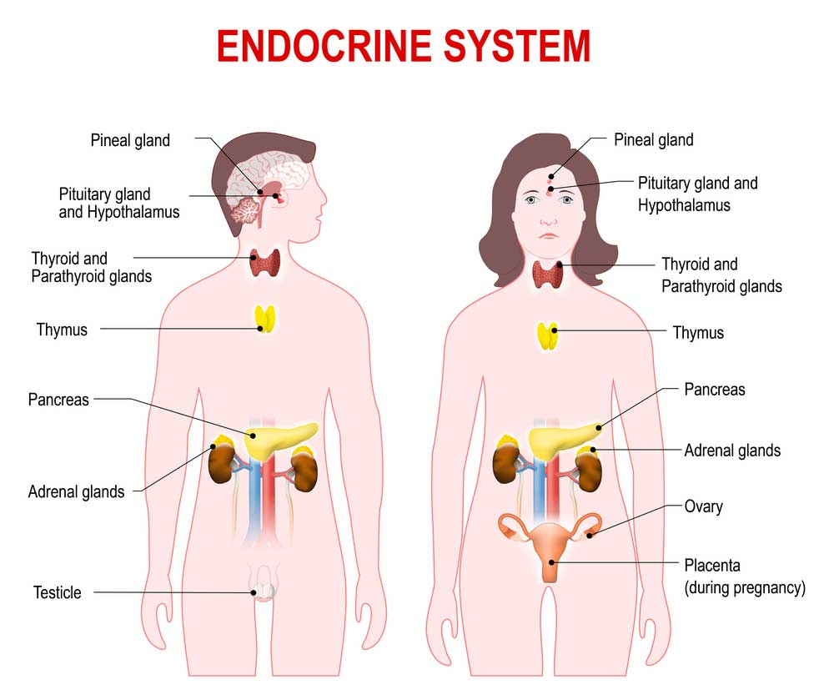

Slide 5
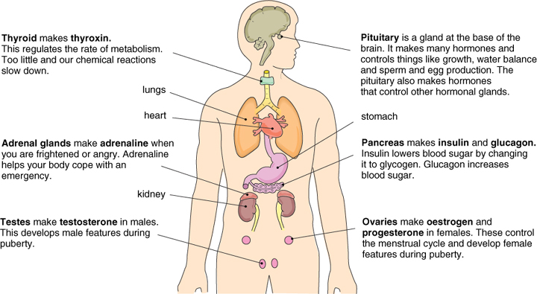
Hormones
https://byjus.com/biology/endocrine-glands-and-hormones/

Slide 6

The endocrine glands
Hypothalamus
This gland is a part of the brain that consists of neurosecretory cells. They connect both nervous and endocrine systems. The hypothalamus secretes ADH and various releasing hormones (RH) like gonadotropin-releasing hormones, growth hormone-releasing hormones. These hormones act on pituitary glands to stimulate other glands.
Pituitary Gland
The pituitary gland is the master gland. This is pea-sized and is located at the bottom of the brain. They control and regulate other glands in the body. Hormones released by this gland are growth hormone, thyroid-stimulating hormone, LH, FSH etc.

Slide 7
The endocrine glands
Pineal Gland
This is also a gland located in the brain. It releases the hormone called melatonin which regulates the wake-up and sleep clock and helps in immunity etc. the pineal gland in the brain responds to light received in the eyes, which causes it to release the hormone melatonin.

Slide 8
The endocrine glands
Thyroid Gland
This is present in front of the neck. It releases the hormones triiodothyronine (T3) and thyroxine (T4). They regulate body metabolism. Iodine is vital for thyroxine synthesis. Its deficiency leads to a disease called goitre.
These hormones (thyroxine and triiodothyronine) control the rate at which cells burn fuels from food to make energy. The more thyroid hormone there is in the bloodstream, the faster chemical reactions happen in the body.
Thyroid hormones are important because they help kids' and teens' bones grow and develop, and they also play a role in the development of the brain and nervous system.
Notes:
These hormones (thyroxine and triiodothyronine) control the rate at which cells burn fuels from food to make energy. The more thyroid hormone there is in the bloodstream, the faster chemical reactions happen in the body.
Thyroid hormones are important because they help kids' and teens' bones grow and develop, and they also play a role in the development of the brain and nervous system.

Slide 9
The endocrine glands
Gonads
Gonads are reproductive glands present in male and female. Male gonad is the pair of testes which secretes the hormone testosterone. This is responsible for the secondary sexual characteristics in males.
Female gonad consists of a pair of ovaries. They secrete two hormones (o)estrogen and progesterone. Both of these regulate the secondary sexual characteristics in females.
These sex hormones affect the development, maturation, and functioning of sex organs and the appearance of secondary sexual characteristics.

Slide 10
The glandular pancreas
The pancreas plays a dual role, being an integral and important part of both the digestive and endocrine systems.
The glandular organ located close to the C-shaped bend of the duodenum, and it can be seen behind the stomach.
It contains cells with an exocrine function that produce digestive enzymes as well as endocrine cells in the islets of Langerhans that produce insulin and glucagon.
The hormones play a role in the metabolism and storage of blood glucose and thus the two different functions of the organ are integrated at a certain level.

Slide 11
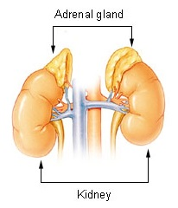
The adrenals
The adrenals are placed above the kidney and therefore also known as suprarenal glands.
Adrenaline is responsible for the ‘fight or flight’ response, when you are excited or frightened or mentally disturbed.
How does our body respond when adrenaline is secreted into the blood?
Heart beats faster
Breathe faster
Increase glucose in blood
More blood diverted to muscle and brain
Less blood flow to digestive system and skin
Pupil enlarge or dilate

Slide 12
Hormones
Hormone | Where produced? | Effects
Growth hormone | Pituitary gland | Controls the growth of your body.
Thyroxine | Thyroid gland | Controls metabolic rate, and growth and development.
Adrenaline | Adrenal glands | Gets your body ready for action by increasing breathing and heart rates.
Insulin | Pancreas | Decreases blood glucose concentrations.
Glucagon | Pancreas | Increases blood glucose concentrations.
Oestrogen | Ovaries | Control female secondary sexual characteristics.
Testosterone | Testes | Control male secondary sexual characteristics.
https://www.everlywell.com/blog/testosterone/how-testosterone-levels-impact-your-metabolism-and-your-health/
https://www.everlywell.com/blog/testosterone/how-testosterone-levels-impact-your-metabolism-and-your-health/
Notes:
Testosterone. In men, this hormone is primarily produced in the testes, while in women it is produced in the ovaries, adrenal glands, and elsewhere in the body. Glands in your brain – such as the pituitary gland – supervise production of testosterone.

Slide 13
Endocrine system diseases
Endocrine system diseases primarily arise from two causes – either a change in the level of hormone secreted by a gland, or a change in the sensitivity of the receptors in various cells of the body. Therefore, the body fails to respond in an appropriate manner to messenger signals.
Q: Can you think of a disease resulting from a hormone disorder?
Among the most common endocrine diseases is diabetes, which hampers the metabolism of glucose.
Diabetes mellitus could either arise from a low level of insulin production from the pancreas (type 1) or an insensitivity of insulin receptors among the cells of the body (type 2).
This has an enormous impact on the quality of life since adequate glucose is not only important for fueling the body, but it is also important in maintaining glucose at an appropriate level to discourages the growth of microorganisms or cancerous cells.

Slide 14
Endocrine system diseases
Another important endocrine gland is the thyroid, with both high and low levels of secretion affecting a person’s capacity to function optimally, even affecting fertility in women. The thyroid also needs a crucial micronutrient, iodine, in order to produce its hormone. Dietary deficiency of this mineral can lead to an enlargement of the thyroid gland (goitre) as the body tries to compensate for low levels of thyroid hormones.
Why is the use of iodized salt advisable?
Usage of Iodized salt is advisable to avoid the deficiency of Iodine. If the intake of iodine is low, the release of thyroxine from the thyroid gland will be decreased. This affects fat, carbohydrate and protein metabolism
Thus a person may have goitre problem if the intake of iodine is lowered.

Slide 15
Comparison: nerves and hormones
Features | Nervous | Endocrine
Structure/ Made of | Neurones/ nerves | Secretory cells/ glands
Form of Information/ electrical or chemical | Electrical impulses | Chemicals
Speed of action | Very fast | Slower
Transmission means/ how is the message transported in body? | Via nerves | Via blood
Area of response | Act on a very precise area | Act on a more general area
Longevity/ duration of action | Short-lived | long-term
The endocrine system provides relatively slow and long-lasting regulation, whereas the nervous system responds rapidly, but briefly.
As an example, the long-term secretion of growth hormone in the body influences the development of bones and muscles to increase height and also induces the growth of every internal organ. This happens over the course of many years.

Slide 16
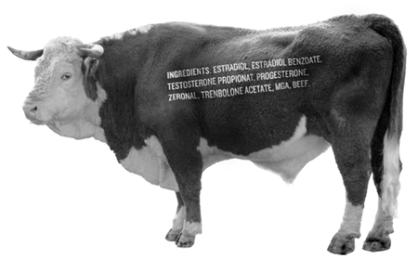
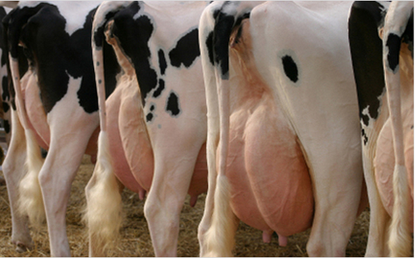
Hormones in food production
Producing very large amounts of milk makes cows more likely to suffer from infections of their udders.
Hormones have also been used in some animals to produce greater muscle volume in a shorter time.

Slide 17
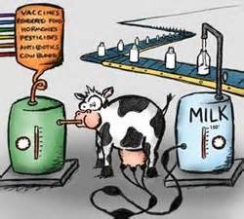
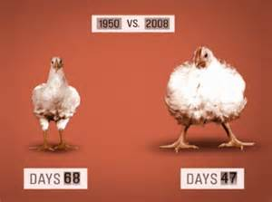
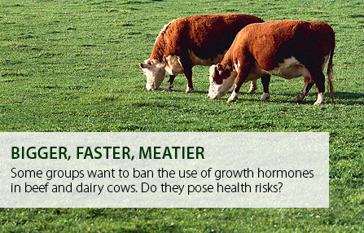

Hormones in food production

